Slide 1
Perioperative Management of Patients on Preoperative Opioid Therapy
04/09/19

Slide 2
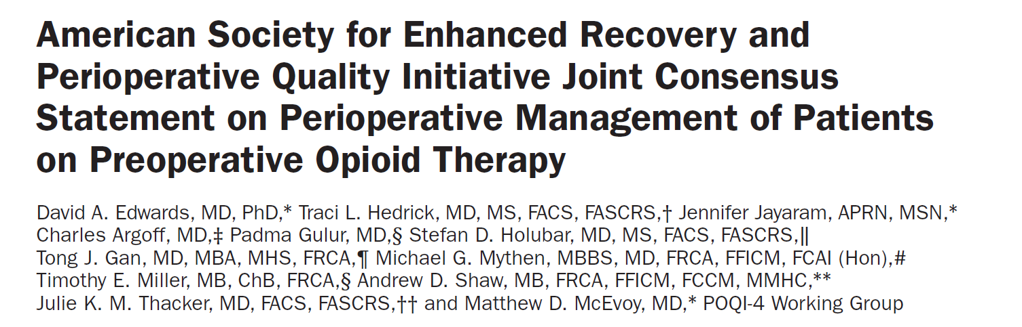
Anesthesia-analgesia,August 2019

Slide 3
Outline
The definitions, categorization, and risk stratification of patients on opioids
Optimal perioperative treatment strategies
Optimal discharge and continuity of care management practices

Slide 4

Introduction
Patients receiving opioids who are scheduled for surgery are at risk of opioid-related morbidity
Requiring risk stratification and unique, multidisciplinary treatment
Notes:
เกริ่นนำ
ต้องมีการประเมินความเสี่ยงและมีแนวทางการรักษาเฉพาะและมีสหสาขาวิชาช่วยดูแล

Slide 5
Introduction
Patients on preoperative opioids have a dose-dependent increased risk of poor surgical outcomes and adverse events related to opioid use in the perioperative period
Notes:
คนไข้กลุ่มนี้

Slide 6
Introduction
Opioid-induced respiratory depression occurs in 0.15%–1.1% of all surgical patients
It is increased 3-fold in opioid-dependent patients
Notes:
เช่น

Slide 7
Introduction
Preoperative opioid use results in other untoward outcomes, such as
  delayed wound healing
  increased surgical reintervention
  prolonged hospital stay
  higher readmission rates
  greater health care costs
  increased mortality
Notes:
เช่น

Slide 8

Introduction
One of the greatest risk factors for prolonged postoperative opioid use and perioperative dose escalation is preoperative chronic opioid use
Notes:
เช่น

Slide 9
Introduction
Preoperative opioid use is a modifiable risk factor that could be optimally managed to improve safety and long-term postoperative outcomes
Notes:
เช่น

Slide 10
Methods
Members of the American Society for Enhanced Recovery representing specialists in surgery, anesthesiology, neurology, pharmacology, nursing, and pain medicine
Review the literature and achieve consensus on recommendations for care of patients receiving preoperative opioids

Slide 11
Methods
The topics chosen were:
1) the definitions of preoperative opioid use
2) the effect of preoperative education and expectation management on perioperative outcomes
3) the potential benefits of preoperative psychological optimization
4) thepotential impact of perioperative pain specialist consultation

Slide 12
Methods
5)the role for multimodal pain management including regional anesthesia and adjunctive medications
6) how perioperative opioids should be managed
7) the optimal perioperative management of patients being treated for opioid use disorder

Slide 13
Methods
Topic 1, definitions of preoperative opioid use, was to sample the literature, and therefore does not represent a comprehensive or systematic review
Topics 2–7, a systematic review was performed

Slide 14
Systematic Search
Using MEDLINE and Embase search engines
Systematic Reviews and Meta-analysis guidelines
Limiting the search to humans, English language, adult patients
Including studies in which patients on opioids preoperatively were identified either as the primary study population or as a subgroup

Slide 15
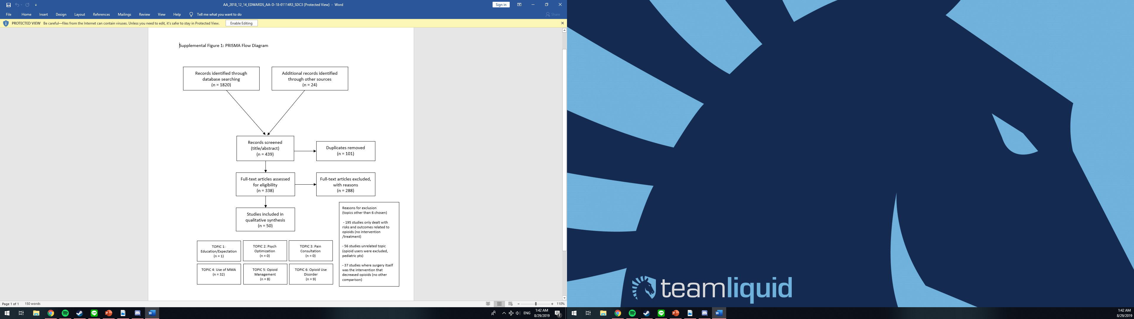
Results

Slide 16
DISCUSSION

Slide 17
Categorizing and Defining Preoperative
Opioid Use
Opioid-naïve
Opioid exposed
Opioid tolerant

Slide 18
Categorizing and Defining Preoperative
Opioid Use
Opioid-naïve
patient having no history of opioid use in the 90 days before surgery
Notes:
We defined opioid-na๏ve as a patient having no history of opioid use in the 90 days before surgery, considering this a sufficient interval to be deemed without increased risk

Slide 19
Categorizing and Defining Preoperative
Opioid Use
Opioid tolerant
patient with a history of ≥60 mg morphine equivalent dose in the 7 days before surgery
US Food and Drug Administration definition of opioid tolerance as a patient “who [is] taking at least 60 mg oral morphine equivalents/day … or an equianalgesic dose of another opioid for 1 week or longer

Slide 20
Categorizing and Defining Preoperative
Opioid Use
Opioid exposed
patient having a history of any opioid exposure <60 mg morphine equivalent dose within 90 days preoperatively
Even short-term and low-dose opioid exposure induces
acquired pharmacokinetic and pharmacodynamic tolerance,
and opioid receptor upregulation, and thus may lead to an
increase in the likelihood of prolonged use or abuse

Slide 22
O-NET → O-NET+
Modifiers
  Uncontrolled psychiatric comorbidities (depression, anxiety, bipolar disease)
  Substance (history of dependency, addiction, or alcoholism)
  Certain type surgery (thoracotomy,spine surgery)

Slide 23
Notes:
We then elected to develop this classification further to allow for its use in stratifying patients preoperatively into low-risk (opioid-na๏ve), moderate-risk (opioid exposed), and high-risk (opioid tolerant) categories
comorbid conditions, social situations, and surgical types can increase the risks of adverse outcomes related to opioids.
as modifiers (addition of the + symbol: O-NET+). Uncontrolled psychiatric comorbidities (such as depression, anxiety, bipolar disease, and
a history of dependency, addiction, or alcoholism) and behavioral tendencies (such as catastrophizing behavior,perceived self-efficacy) impact pain behaviors and opioid use

Slide 24
O-NET+
An advantage of using the classification scheme in the preoperative period is that modifiable factors can be identified and treated, or at a minimum, a plan instituted to manage the condition in the perioperative period
A patient’s O-NET+ risk category could be lowered, better optimizing them for surgery

Slide 25
O-NET+
Not all risk factors will be treatable in the lead time to surgery, and complete optimization may not be feasible
However identifying the risks and establishing a plan to manage these there is the potential for improving the outcome and experience for the patient

Slide 26
Education, Expectation Management
We recommend individualized preoperative education to promote shared pain management expectations

Slide 27
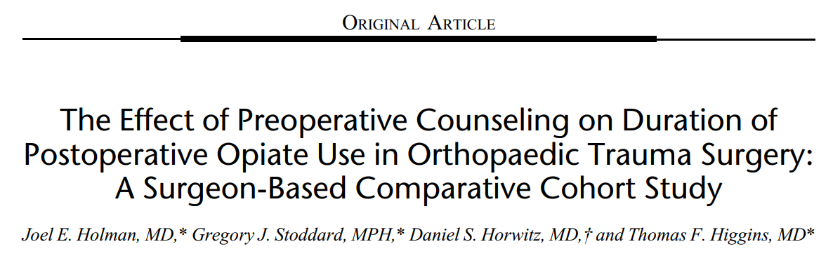
Results: Six hundred thirteen patients met inclusion criteria. Those counseled preoperatively to cease opiate use by 6 weeks were significantly more likely to do so than those who did not receive counseling (73% and 64%, respectively; P = 0.012)

Slide 28
Education, Expectation Management
Optimization of care for the surgical patient begins in the clinic with identification and stratification of at-risk patients
Preoperative patient expectation management results in improved postoperative patient satisfaction and decreased need for opioids

Slide 29
Education, Expectation Management
Patients with chronic pain or substance use disorders are likely to be apprehensive about their pain control or risk of relapse around surgery
These patients especially should be introduced to the multimodal pain management

Slide 30
Education, Expectation Management
They should also be informed of the relatively increased risks of being on opioids before surgery and educated on the adverse effects of opioids both in the perioperative setting and with prolonged use
Notes:
These topics should be initiated in the surgeon’s office and continued throughout the preoperative period at subsequent encounters.

Slide 31
Psychological Optimization
Recognizing the presence of complex psychosocial issues and comorbid psychiatric illness in the patient on chronic opioid therapy is of utmost importance to improve outcomes
depression, anxiety, posttraumatic stress disorder, borderline personality disorders, etc.

Slide 32
Psychological Optimization
Screening and risk stratification for modifiable comorbid conditions that might benefit from preoperative interventions to improve resilience and coping skills that could mitigate opioid dose escalation and self-medication of negative emotions with opioids

Slide 33
Psychological Optimization
Mindfulness-based training
Focus on chronic pain
Improving the psychological impact and quality of life of the pain experience
Potential to improve current pain management strategies for patients on opioids who are at risk of suffering after surgery

Slide 34
Perioperative Pain Specialist Consultation
We recommend identification of and communication with the patient’s outpatient opioid prescriber to anticipate discharge needs
We recommend referral to a Perioperative Pain Specialist before surgery for highest risk patients

Slide 35
Perioperative Pain Specialist Consultation
A well-planned and communicated strategy for delivering multimodal analgesia historically the specialty domain of pain management specialists, almost certainly improves the safety, quality, cost, and coordination of care
Consultation with a specialized, dedicated acute pain, or perioperative consult service continues to be a strong recommendation from multiple expert panels

Slide 36
Perioperative Pain Specialist Consultation
Enhanced recovery pathways, the perioperative surgical home, and the transitional pain service are organization responses to improve recovery and reduce the prolonged negative outcomes related to surgery (chronic pain and opioid use among them)

Slide 37
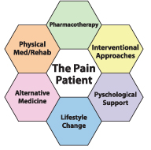
Multimodal Pain Management Strategies
We strongly recommend that an individualized multimodal analgesia pain management strategy be used, including regional/neuraxial anesthesia when appropriate, to minimize the use of opioids

Slide 38
Multimodal Pain Management Strategies
We strongly recommend the routine use of nonopioid options as part of a comprehensive multimodal analgesia perioperative analgesia plan
We strongly recommend the use of nonpharmacological treatments of pain

Slide 39
Perioperative Pain Management in Patients on Preoperative Opioids
The multimodal analgesia regimens included multiple medications, nonopioid and opioid combinations, to attain pain control while limiting side effects
Primary objective for pain management in patients on preoperative opioids is to treat acute pain while preventing withdrawal and avoiding persistent opioid escalation beyond the baseline dose

Slide 40
Perioperative Pain Management in Patients on Preoperative Opioids
Many patients with chronic pain on opioids may already be on a multimodal analgesia pain treatment regimen designed to treat chronic pain
The strategy of maximizing and optimizing a multimodal analgesia regimen could include increased doses, rotation of medication or addition of medication of another class

Slide 41
Perioperative Pain Management in Patients on Preoperative Opioids
Adjustments to dose, frequency, or timing of medications may be needed to assist with postoperative recovery and to prevent side effects such as sedation, delirium, and respiratory depression of concurrent therapies

Slide 42
Perioperative Opioid Management
Weaning opioids preoperatively to the lowest effective dose depending on the patient’s underlying condition
Lowest effective opioid dose in the postoperative period
Avoiding opioid dose escalation
Add opioids only in the setting of suboptimal analgesia after first-line administration of non-opioid options

Slide 43
Perioperative Opioid Management
Recommend limiting discharge opioid prescription to the expected duration of pain that is severe enough to require opioids
recommend postoperative coordination of opioid tapering with the patient’s outpatient provider
recommend the continuation of multimodal therapy throughout the convalescence after surgery ,and as long as the patient continues to require additional opioids

Slide 44
Perioperative Opioid Management
Recommend limiting discharge opioid prescription to the expected duration of pain that is severe enough to require opioids
Recommend postoperative coordination of opioid tapering with the patient’s outpatient provider

Slide 45
Preoperative Opioid Reduction
One reason for developing the O-NET+ classification scheme is to understand the correlation between preoperative opioid dose and poor outcomes
It is possible that a protocol based preoperative opioid reduction strategy for chronic opioid users would improve those outcomes

Slide 46
Preoperative Opioid Reduction
McAnally proposed delaying elective surgery when feasible for a 10- to 12-week multidisciplinary preoperative optimization program for chronic pain patients
  opioid reduction
  reducing pain catastrophizing
  prehabilitation

Slide 47
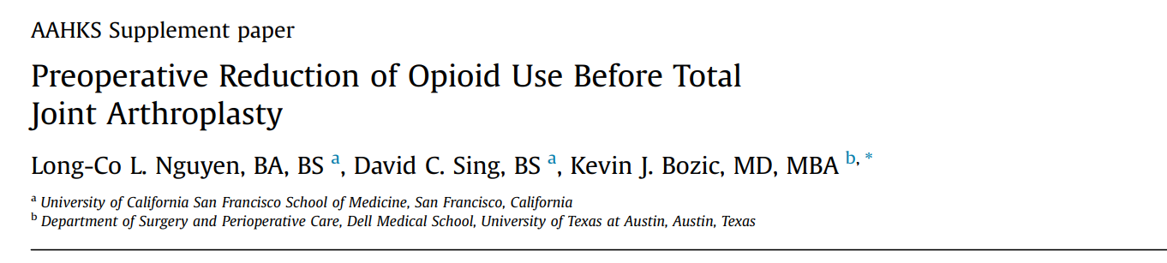
Patients using opioids who successfully weaned had greater improvements in both disease specific and generic measures of health outcomes than patients who did not wean

Slide 48
Preoperative Opioid Reduction
The data being limited to support preoperative tapering
Suggests weaning to the lowest effective dose, depending on the patient’s underlying condition

Slide 49
Day of Surgery Opioid Management
Expert consensus, recommends continuation of a patient’s typical dose of prescribed opioid on the morning of surgery with intraoperative analgesia sufficient to treat surgical pain

Slide 50
Day of Surgery Opioid Management
Opioid-free intraoperative analgesia is possible and most common when regional anesthesia is used
Opioid-free intraoperative analgesia also possible when multimodal protocols are used during general anesthesia
General anesthesia can be avoided in many surgeries in which effective regional anesthesia blocks are sufficient

Slide 51
Day of Surgery Opioid Management
It is our conclusion that opioid-free intraoperative management is feasible and we suggest that it may be appropriate
However, there are insufficient data to recommend it

Slide 52
Postoperative Opioid Management
Expert consensuses universally recommend opioid-sparing techniques
In an opioid-tolerant patient, the goal may be even more important to limit postoperative opioid escalation and associated increased incidence of opioid-related adverse events

Slide 53
Postoperative Opioid Management
A multimodal analgesic approach may decrease or slow opioid dose escalation reduce the incidence of adverse events and allow more patients to wean off opioids in the postoperative period

Slide 54
Postoperative Opioid Management
In patients on preoperative opioids, there is a balance between adequate pain relief and avoidance of opioid-related adverse events, and recovery should be closely monitored, especially given the potential for high opioid requirements (as high as 3- to 4-fold over opioid-naïve patients)

Slide 55
Postoperative Opioid Management
Patients on opioids have increased overall risk for suffering if undertreated, and of adverse events if overtreated

Slide 56
Postoperative Opioid Management
Patients of low-socioeconomic status lack resources and access to medical care, increasing the risk of prolonged use of opioids and opioid-related adverse events
Transitional pathways should consider the continuum of care to ensure long-term safety and optimal outcomes especially for this group of patients

Slide 57
Postoperative Opioid Management
Postoperative prescribing should provide sufficient pain medication to allow for functional recovery for the duration of severe pain expected for the surgical type

Slide 58
Postoperative Opioid Management
Emphasis on function first, and opioids last
A strategy to treat acute postoperative pain ideally maximizes nonopioid medications and nonmedication options before, or at least concurrent with, prescribing opioids

Slide 59
Postoperative Opioid Management
Recommend the lowest effective opioid dose for the shortest duration in the postoperative period
While short-term dose escalation is reasonable to treat perioperative pain, we recommend avoiding persistent escalation of chronic doses of opioids
Deescalation and cessation of opioids when appropriate should be planned

Slide 60
Discharge Prescriptions and Opioid Taper
Surgical procedures with expected significant or prolonged postsurgical pain may warrant discharge prescription of opioids above a patient’s preoperative dose
Consultation with a psychologist, psychiatrist, pain specialist, or addiction specialist may be necessary if continued opioid use occurs beyond the expected duration of acute postoperative pain

Slide 61
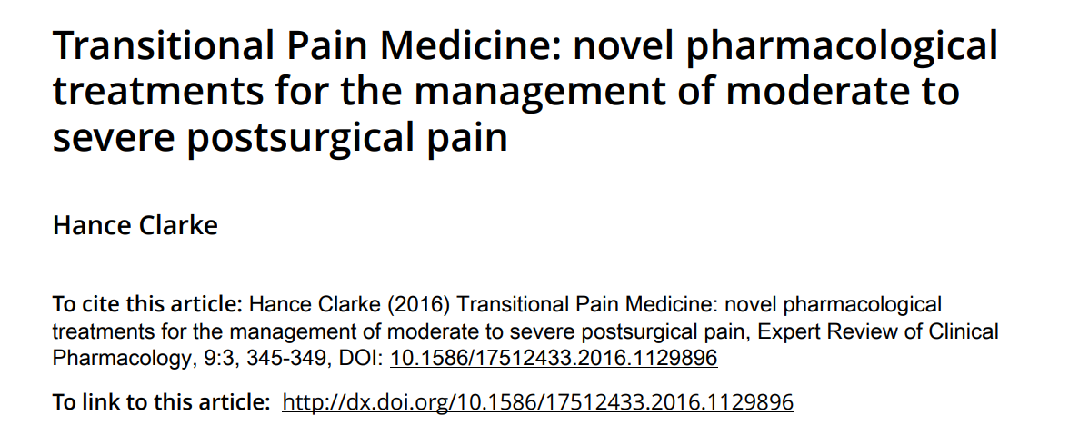
Approximately 12.5% of patients present to surgery on preoperative opioids and historically were discharged on 100%–300% increase over baseline dose of their original opioid, without a plan to wean
Notes:
Clarke76 reports on the development of a Transitional Pain
Service at Toronto General Hospital to address the gaps in the
perioperative care continuum with respect to pain and functional
recovery

Slide 62
Discharge Prescriptions and Opioid Taper
Opioid weaning guidance after surgery is limited and mostly comes from expert opinion in clinical guidelines

Slide 63
Discharge Prescriptions and Opioid Taper
Ensuring adequate follow-up for postoperative pain management should be a priority, including coordinating care with a patient’s opioid prescriber, pain management provider, psychiatrist, and/or psychologist

Slide 64
Substance Dependence, Substance Use Disorder
The patient on maintenance opioid agonist therapy (medication-assisted therapy) warrants special consideration in perioperative management

Slide 65
Substance Dependence, Substance Use Disorder
Medication-assisted therapy utilizes controlled doses of long-acting opioids to prevent withdrawal and minimize euphoria
Designed to reduce drug craving and drug misuse, medication-assisted therapy also reduces levels of drug abuse, offending, and overdose risk in patients with opioid dependence

Slide 66
Substance Dependence, Substance Use Disorder
Methadone and buprenorphine are the 2 most commonly used drugs for medication-assisted therapy
Patients on methadone should be continued on their maintenance dose throughout the perioperative period

Slide 67
Substance Dependence, Substance Use Disorder
Patients on buprenorphine may require high-affinity opioids to help overcome the blocking effect of this partial agonist

Slide 68
Substance Dependence, Substance Use Disorder
For patients on buprenorphine, 3 strategies have been recommended
continuation of buprenorphine at the maintenance dose
perioperative escalation for improved pain management
switching to full agonist opioid therapy before surgery

Slide 69
Substance Dependence, Substance Use Disorder
It is recommended to coordinate care with the outpatient psychiatrist, psychologist, or other prescriber treating the patient with medication-assisted therapy

